Slide 1
V JAIGANESH
REG NO : 211521243069
COLLEGE NAME :PANIMALAR INSTITUTE OF TECHNOLOGY
Final Project
3/21/2024 Annual Review

Slide 2
English to french translation using RNN
How it Works: Imagine an RNN as a smart machine that reads an English sentence word by word. It learns the relationships and order of the words. Then, it uses this knowledge to build a corresponding French sentence, one word at a time.
3/21/2024 Annual Review

Slide 3


AGENDA
Introduction (1-2 min)
What is English-to-French translation with RNNs?
RNN Basics (2-3 min)
Understanding Recurrent Neural Networks (RNNs)
The Translation Process (4-5 min)
How RNNs translate sentences: Data, Word Embeddings, and Architecture
Benefits of RNNs (Optional: 1 min)
Why use RNNs for translation?
Conclusion (1-2 min)
Key takeaways and future of RNN translation
3/21/2024 Annual Review

Slide 4

PROBLEM STATEMENT
The challenge is to develop a French-English translator using a Recurrent Neural Network (RNN). The translator should accurately and efficiently convert text from French to English and vice versa.
3/21/2024 Annual Review

Slide 5

PROJECT OVERVIEW
The project aims to develop a French-English translator using a recurrent neural network (RNN), enhancing communication across language barriers. It will focus on natural language processing and deep learning techniques to ensure accurate and efficient translation.
3/21/2024 Annual Review

Slide 6

WHO ARE THE END USERS?
Language Learners
Individuals who want to understand and communicate effectively in both French and English.
Students and Professionals
Those seeking to improve their language skills for academic, career, or personal development purposes.
Travelers
People who aspire to navigate French-speaking regions with confidence and ease.
3/21/2024 Annual Review

Slide 7
YOUR SOLUTION AND ITS VALUE PROPOSITION
Our solution, a French-English translator using RNN, offers a powerful and efficient way for users to communicate across language barriers.
By utilizing the latest advances in machine learning, we are able to provide accurate and reliable translations that help bridge the gap between people from different cultures and backgrounds.
3/21/2024 Annual Review

Slide 8
THE WOW IN YOUR SOLUTION
Improved Efficiency
Streamlining processes to save time and resources.
Enhanced User Experience
Providing a seamless and intuitive interface for users.
Advanced Technology Integration
Incorporating cutting-edge tools and innovations into the solution.
3/21/2024 Annual Review

Slide 9
MODELLING
Data Collection
Gathering relevant and accurate data sources
Preprocessing
Cleaning and transforming data for analysis
Model Development
Building and training the RNN model
As we move into the modelling phase, the process involves data collection from various sources to ensure the availability of quality data. This will be followed by preprocessing the data, removing any noise or inconsistencies. Finally, we will embark on developing the RNN model, carefully training it for accurate translation.
3/21/2024 Annual Review

Slide 10
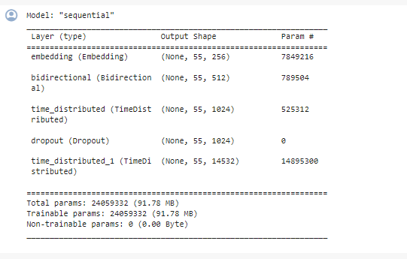
RESULTS
https://github.com/jaiganesh362/TNSDC-GEN-AI
3/21/2024 Annual Review

